Slide 1

Calendars

Slide 2

Objective
To find the day of the week, for any given date.
For example: 15th August 1947?

Slide 3
Introduction
From tomorrow onwards every 7th day is today.
i.e. after every 7 days, it is today.
after 8 days → tomorrow,
after 10 days → today +3,
after 50 days → today +1,
after 100 days → today +2, like wise

Slide 4
Types of years
Non-Leap Year or Regular Year:
365 days → 52 weeks + 1 day ( i.e. 1 odd day)
Leap Year:
366 days → 52 weeks + 2 days ( i.e. 2 odd days)
If for a leap year, the given year is exactly divisible by 4 (except for centuries)
A century to be a leap year, it must be divisible by 400.
1972, 2012, 1924, 1600, 2000 etc. are leap years.
1978, 1990, 1900 1700, 1862 etc. are non leap years.

Slide 5
Examples
E.g. 1. How many odd days are there in the year 1994?
The year 1994 is a non leap year, it has 1 odd day.
E.g. 2. How many odd days are there in the month October?
October has 31 days, i.e. 4 weeks and 3 odd days.
E.g. 3. When can we use the same calendar of 2017?
2018 – 1 odd day, 2019 – 1 odd day, 2020 – 2 odd days, 2021 – 1 odd day, 2022 – 1 odd day, 2023 – 1 odd day Got the sum a multiple of 7.
Therefore 2023.

Slide 6

Quiz 1
1. How many odd days are there in the year 2200?
a. 0 b. 1 c. 2 d. none of these
2. If today is Tuesday, then which day it will be after 79 days?
a. Thu b. Fri c. Sat d. Sun
3. Which year we used the calendar of 2015?
a. 2007 b. 2008 c. 2009 d 2004

Slide 7
Repeating Calendars
Calendars of non-leap years of the form 4n and 4n+1 repeat after 6 years.
E.g. Calendar of the year 1900 repeats in 1906, 2017 repeats in 2023.
Calendars of non-leap years of the form 4n+2 and 4n+3 repeat after 11 years.
E.g. Calendar of the year 2018 repeats in 2029,
2019 in 2030.
Leap years repeat every 28 years.
Hence 2020 will repeat in 2048.

Slide 8
Odd days in the first n years
Last day of BC was Sunday.
i.e. AD 01.01.0001 was a Monday.
So from 01.01.0001 to any given date, if we get
0 odd day → Sunday
1 odd day → Monday
2 odd days → Tuesday
3 odd days → Wednesday
4 odd days → Thursday
5 odd days → Friday
6 odd days → Saturday

Slide 9
Odd days in Centuries
In the first 100 years:
76 non leap years → 76×1 odd day = 76 odd days &
24 leap years → 24×2 odd days = 48 odd days
Therefore 124 odd days, i.e. 5 odd days.
Hence 100 years → 5 odd days
⇒ 200 years → 10 odd days → 3 odd days
300 years → 15 odd days → 1 odd day
400 years → 20+1 odd days → 0 odd day.
This pattern repeats.
i.e. 500 years → 400+100 years → 5 odd days, so on.

Slide 10
Example 4
Find the day of the week we got independence?
i.e. to calculate the number of odd days from 01.01.0001 to 15th Aug 1947.
So 1946 complete years + Jan to Aug 15th of 1947.
i.e. 1600 years + 300 years + 46 years + Jan + Feb +
↓ ↓ ↓ ↓ ↓ (0) (1) (1) (3) (0)
Mar + Apr + May + Jun + Jul + Aug 15th
↓ ↓ ↓ ↓ ↓ ↓
(3) (2) (3) (2) (3) (1)
Total 19 odd days, i.e. 5 odd days, therefore Friday.

Slide 11
Example 5
It was Sunday on Jan 1, 2006.
What was the day of the week Jan 2, 2010?
a. Sun b. Sat c. Fri d. Wed
Given Jan 1, 2006 was Sunday.
Number of odd days from the year 2006 to the year 2009
= (1 + 1 + 2 + 1) = 5 days.
January 1, 2010 was Friday.
Therefore, Jan 2, 2010 must be Saturday.

Slide 12

Quiz 2
If 2nd Oct 1807 is a Sat, then 2nd Oct 2007 is a
a. Mon b. Tue c. Wed d. Thu
In the year 1648, if the Feb month has 5 Sun, what is the day on 13th Feb 1750?
a. Sun b. Fri c. Sat d. Mon
What was the day of the week on 28th February 1990?
a. Wed b. Thu c. Fri d. Sat

Slide 13
Dooms day Concept
In any year, the following dates falls on the same day.
Last day of February = 4/4 = 6/6 = 8/8 = 10/10 = 12/12.
Also 9/5= 5/9 = 11/7 = 7/11.
(I work from 9 am to 5 pm on 7th to 11th).
Also pi day = 3/14 (14th of March).
This day is called Dooms day of that year

Slide 14
Anchor days
Certain days are defined as anchor day for the following centuries.
1800 – 1899 → 5 (Friday)
1900 – 1999 → 3 (Wednesday)
2000 – 2099 → 2 (Tuesday)
2100 – 2199 → 0 (Sunday)
Since calendars repeats for every 400 years, this pattern also repeats.

Slide 15

Dooms day formula
$$Dooms day= Anchor day+\left[\frac{yy}{12}\right]+R\left(\frac{yy}{12}\right)+\left[\frac{R\left(\frac{yy}{12}\right)}{4}\right]$$
where ‘yy’ denotes the last two digits of the year and R is the remainder.

Slide 16

Assignment
Qn. 1. How many of the following statements must be true?
No year can have 5 Sundays in the month of May and 5 Thursdays in the month of June
If Feb 14th of a certain year is a Friday, May 14th of the same year cannot be a Thursday
If a year has 53 Sundays, it can have 5 Mondays in the month of May
A. 0 B. 1 C. 2 D. 3
Qn. 2. John was born on Feb 29th of 2012 which happened to be a Wednesday. If he lives to be 101 years old, how many birthdays would he celebrate on a Wednesday?
A. 3 B. 4 C. 5 D. 1

Slide 17


Assignment
Qn. 3. On what dates of April 2001 did Wednesday fall?
a.1st, 8th, 15th, 22nd, 29th
b.2nd, 9th, 16th, 23rd, 30th
c.3rd, 10th, 17th, 24th
d.4th, 11th, 18th, 25th
Qn. 4. If 30th January 2003 was Thursday,
what was the day on 2nd March 2003?
a. Sunday
b. Tuesday
c. Wednesday
d. Friday

Slide 18


Assignment
Qn. 5. Three days ago I met my friend and asked him to lend me his Mathematics book. He promised that he will lend it on the eighth day from that day. If today is Thursday, on which day will he lend me the book?
Friday
Tuesday
Monday
Sunday
Qn. 6. The last day of a century cannot be
Monday
Tuesday
Thursday
b & c
Friday

Slide 19
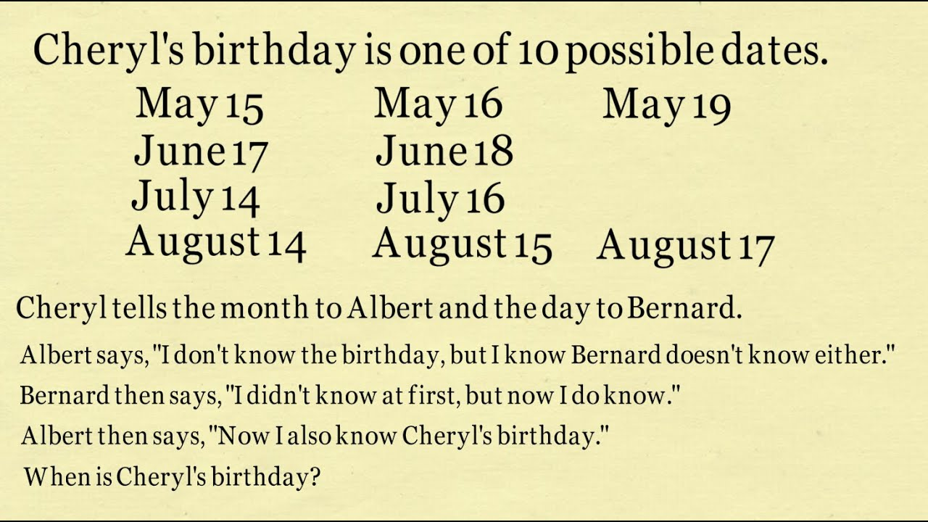
Puzzles 1. Dec 31st 2. July 16
Qn. 1. If Lata says ”Day before yesterday I was 25 years old and next year I will be 28 years old”, What day is Lata’s birthday?
Qn. 2.

Slide 20

Thank you Narayan CIR

